Slide 1
Physical Computing
Raspberry Pi Pico and Micro-Python
2023

Slide 2
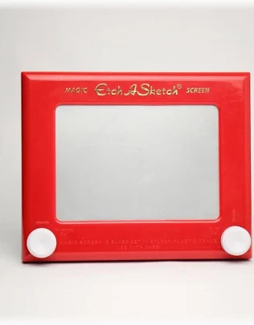
Lesson 5 Starter Activity
Do you know what this object is?
How do you think it works?
Notes:
If students have completed homework investigation they should have an idea on what the device is and how it works

Slide 3
In this lesson you will
Consolidate your learning by creating an electronic version of an Etch a Sketch drawing console
Combining inputs and outputs together to mimic real world systems
Learn how to remove “shake” from an analogue input device

Slide 4
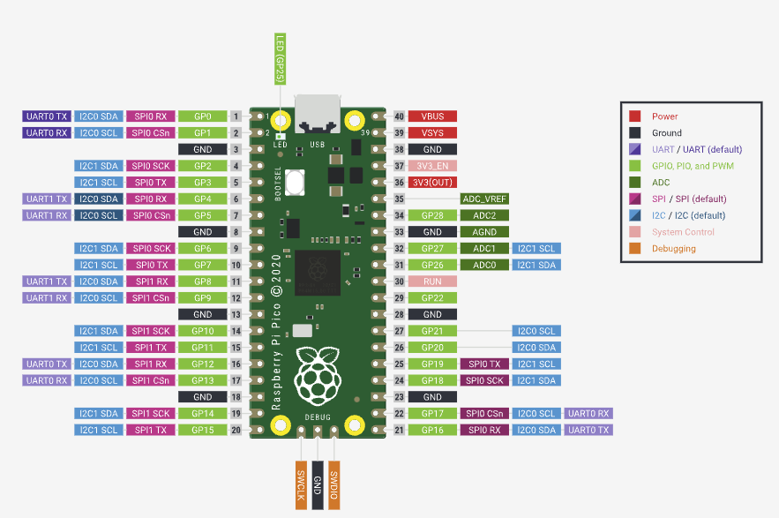
The Pico RP2040 Microcontroller
Your final circuit includes the following
1 button
2 potentiometers
1 OLED

Slide 5
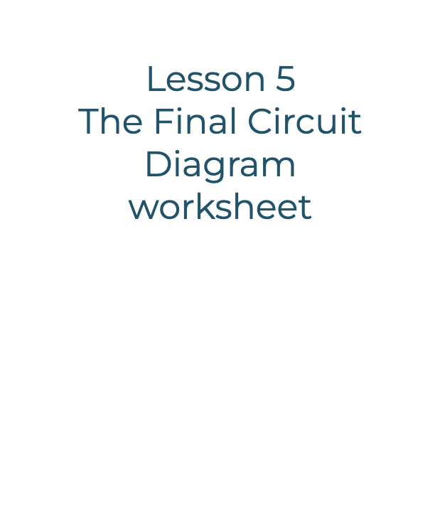
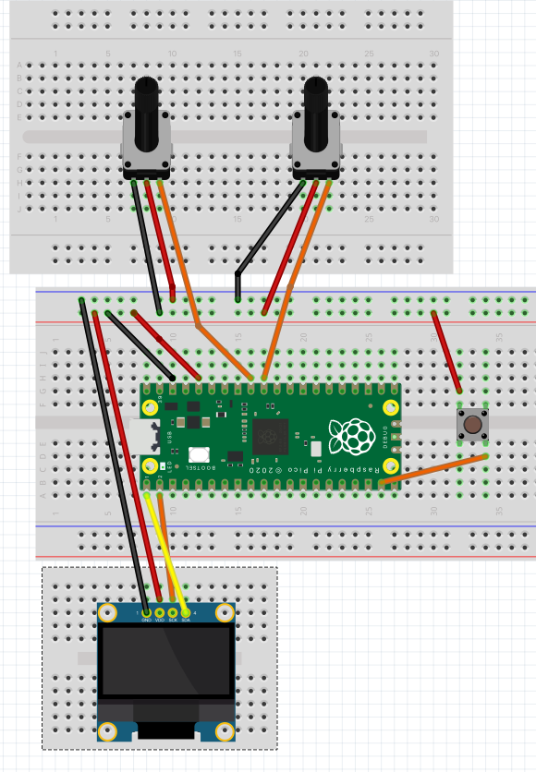
Use the worksheet to complete or check your final circuit

Slide 6
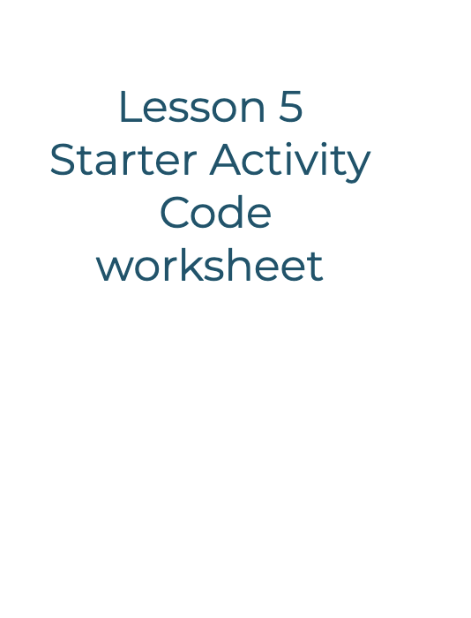
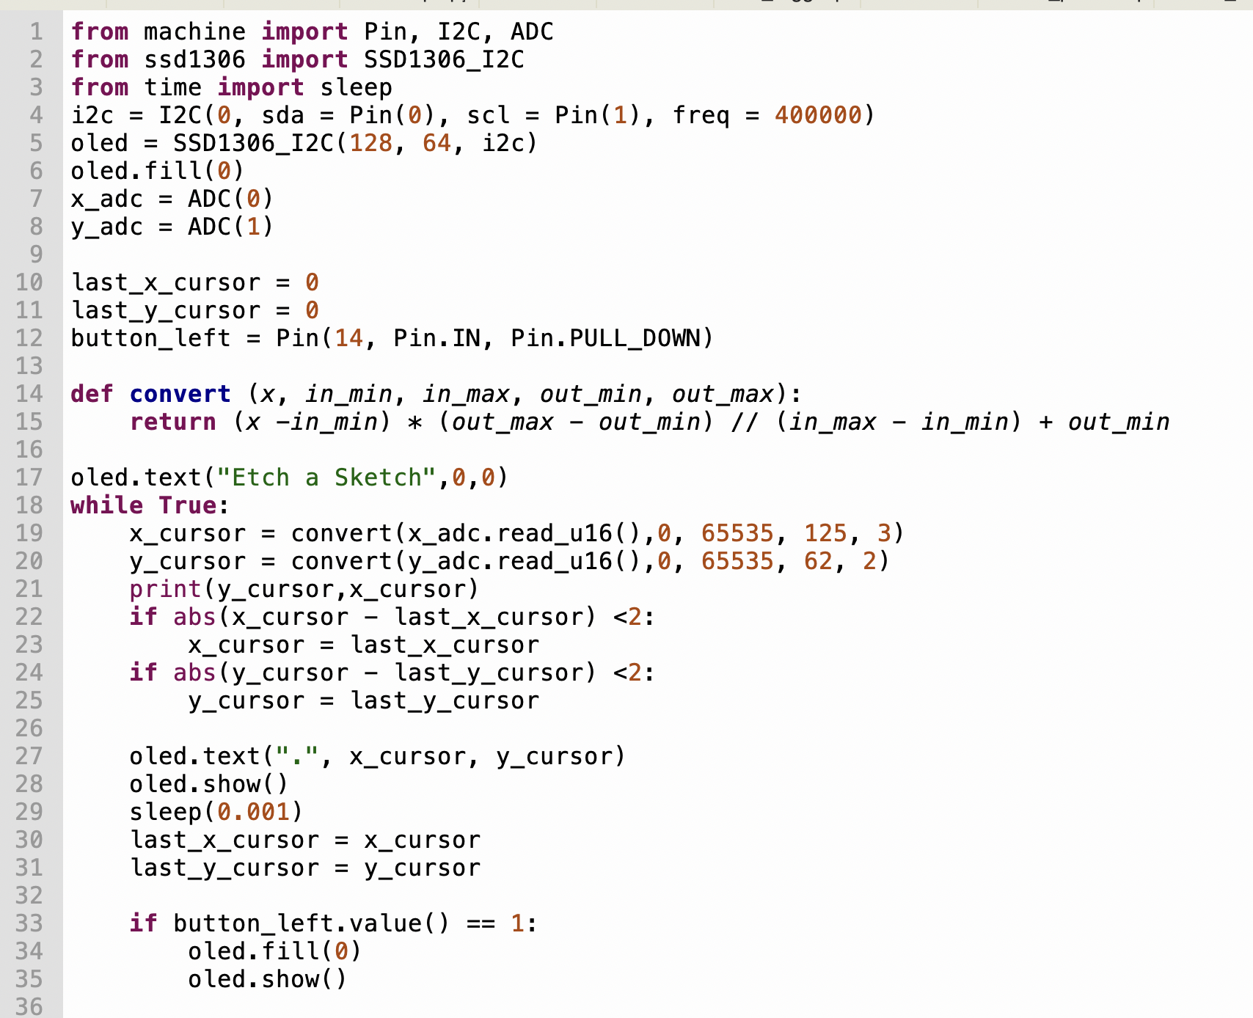
Take a look at the code on the worksheet and
annotate the elements you recognise
Notes:
# Import necessary modules from the MicroPython library
from machine import Pin, I2C, ADC
from ssd1306 import SSD1306_I2C
from time import sleep
This line imports the required modules for working with the Raspberry Pi Pico's hardware. It imports classes for general-purpose input/output (GPIO) pins (`Pin`), Inter-Integrated Circuit (I2C) communication (`I2C`), Analog-to-Digital Conversion (`ADC`), and an SSD1306 OLED display driver (`SSD1306_I2C`). Additionally, it imports the `sleep` function from the `time` module for introducing delays in the program.
# Set up I2C for communication with the OLED display
i2c = I2C(0, sda=Pin(0), scl=Pin(1), freq=400000)
oled = SSD1306_I2C(128, 64, i2c)
oled.fill(0) # Clear the OLED display
Here, an I2C object (`i2c`) is created with specified GPIO pins for the data (SDA) and clock (SCL) lines. Then, an OLED display object (`oled`) is initialized with a resolution of 128x64 pixels using the SSD1306_I2C driver. The `fill(0)` method is used to clear the OLED display by setting all pixels to black (0).
# Set up ADC (Analog-to-Digital Converter) for reading values from potentiometers
x_adc = ADC(0)
y_adc = ADC(1)
Two ADC objects (`x_adc` and `y_adc`) are created to read analog values from two different channels (0 and 1). These channels are typically associated with physical pins on the Raspberry Pi Pico.
# Initialize variables to store the last cursor position
last_x_cursor = 0
last_y_cursor = 0
Variables `last_x_cursor` and `last_y_cursor` are initialized to store the previous cursor positions.
# Set up a button (button_left) to clear the OLED screen
button_left = Pin(14, Pin.IN, Pin.PULL_DOWN)
A button is configured using GPIO pin 14 (`Pin(14)`) as an input (`Pin.IN`) with a pull-down resistor enabled (`Pin.PULL_DOWN`). This means that when the button is not pressed, the pin is pulled down to a logical low state.
# Function to map a value from one range to another
def convert(x, in_min, in_max, out_min, out_max):
return (x - in_min) * (out_max - out_min) // (in_max - in_min) + out_min
This function (`convert`) takes a value `x` and maps it from the range `[in_min, in_max]` to the range `[out_min, out_max]`. It is used to map analog readings to cursor positions on the OLED display.
# Display "Etch a Sketch" at the top of the OLED screen
oled.text("Etch a Sketch", 0, 0)
The text "Etch a Sketch" is displayed at the top-left corner of the OLED display.
`
# Main loop to continuously read values from potentiometers and update the OLED display
while True:
# Read analog values from potentiometers and map them to cursor positions
x_cursor = convert(x_adc.read_u16(), 0, 65535, 125, 3)
y_cursor = convert(y_adc.read_u16(), 0, 65535, 62, 2)
print(y_cursor, x_cursor) # Print cursor positions (for debugging)
# Remove cursor shake: adjust as needed to smooth lines
if abs(x_cursor - last_x_cursor) < 2:
x_cursor = last_x_cursor
if abs(y_cursor - last_y_cursor) < 2:
y_cursor = last_y_cursor
# Create a dot at each cursor position on the OLED display
oled.text(".", x_cursor, y_cursor)
oled.show() # Update the OLED display
# Small sleep to allow for screen refresh (adjust as needed)
sleep(0.001)
# Keep track of the cursor's last position
last_x_cursor = x_cursor
last_y_cursor = y_cursor
# Check if the button is pressed to clear the screen
if button_left.value() == 1:
oled.fill(0) # Clear the OLED display
oled.show() # Update the OLED display to reflect the clearing
```
The main loop continuously reads analog values from the potentiometers, maps these values to cursor positions, and displays a dot at each position on the OLED display. It includes a mechanism to reduce cursor shake and a small delay for screen refresh. The loop also checks if the button is pressed to clear the OLED display if needed. The loop runs indefinitely (`while True`).

Slide 7
How it works
A single pixel will be displayed on the screen
The potentiometers will read movement and move the cursor turning on the pixel at each point
The button clears the screen

Slide 8
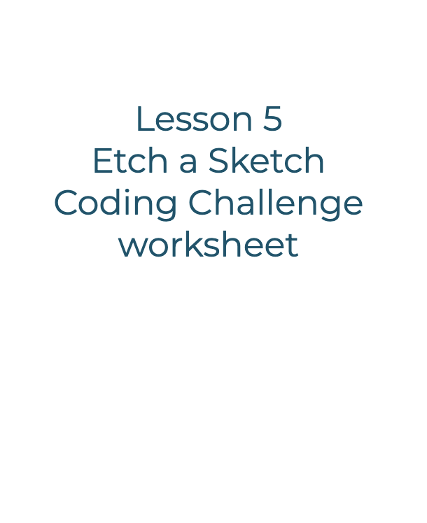
Coding the Etch a Sketch
Use the worksheet to help you program the Etch a Sketch

Slide 9
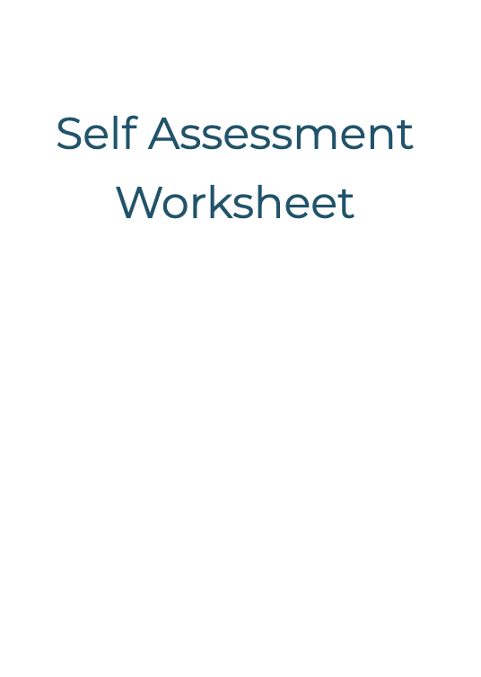
Plenary
Self assessment reflection
Use the worksheet to reflect on the unit

